Slide 1
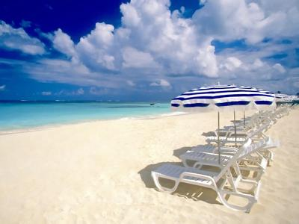
Itinerary

Slide 2
Itinerary
an established line of travel or access
a guidebook for travelers
a proposed route of travel
It includes the advice on what to see and do,
maps, city guides, local transportation, local
customs and festivals, etc.

Slide 3
Date | Sites | Stay at | Travel by
2017.7.15 | Hangzhou-Vancouver 11:05- 11:10Vancouver -Ottawa | Courtyard Ottawa East 200 Coventry Road, K1K 4S3 Ottawa | Flight CA 1510/991
7.15-7.17 | Ottawa | Courtyard Ottawa East 200 Coventry Road, K1K 4S3 Ottawa | car
7.18 | Ottawa-2h-Kingston | Residence Inn by Marriott Kingston Water's Edge 7 Earl Street,Kingston , K7L 0A4 | car
7.19 | Kingston-2.5h-Toronto-1.5h-Nigara Fall | Hilton Hotel and Suites Niagara Falls/Fallsview 6361 Fallsview BoulevardNiagara Falls, L2G 3V9 | car
7.20 | Toronto | Residence Inn by Marriott Toronto Airport 17 Reading Court Etobicoke Toronto , M9W 7K7 | car
7.21 | Toronto-CalgaryCrossIron Mills shopping | Lakeview Signature Inn 2622 39th Avenue Northeast, T1Y 7J9 14037353336 | Flight
7.22-7.24 | Calgary-1A-(Canmore)-banff-Lake louise | Lake Louise Inn 210 Village Road PO BOX 209, Lake Louise, T0L 1E0 | car
7.25 | Lake Louise-(232km)3h-Jasper | Dave & Honey's Accommodation 804 Turret Street, T0E 1E0 ，Jasper 1780852727 | car
7.26 | Jasper-(321km)4h- Golden | Kapristo Lodge 1297 Campbell Road, V0A 1H7 12503446048 | car
7.27 | Golden-Vancouver | Robson Suites 777 Bidwell Street, V6G 3B9 +16046859777 | car
7.28-8.1 | Vancouver | Robson Suites 777 Bidwell Street, V6G 3B9 +16046859777 | car
8.2 | Vancouver-Hangzhou10:40-18:30 |  | FlightCA998/1563

Slide 4
Preparation
Booking
Getting Ready to Go

Slide 5
Preparation
www.baidu.com
www.wikipedia.org
www.mafengwo.cn
www.eueueu.com

Slide 6
Booking
www.qunaer.com
www.skyscanner.com
www.airasia.com
www.airasiago.com

Slide 7
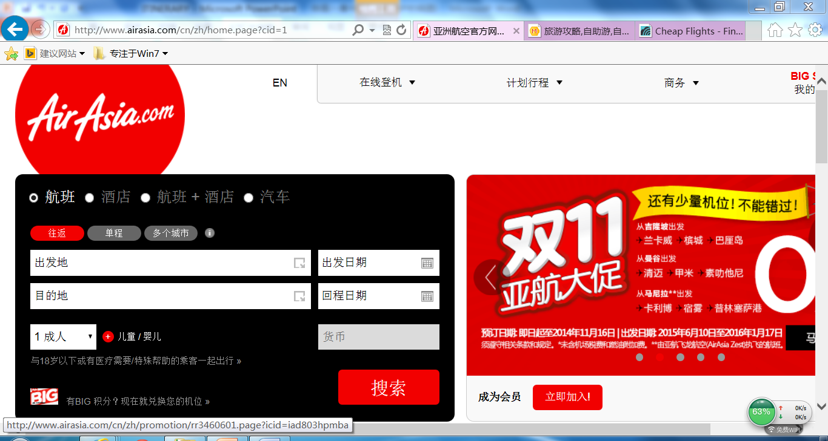
www.airasia.com

Slide 8
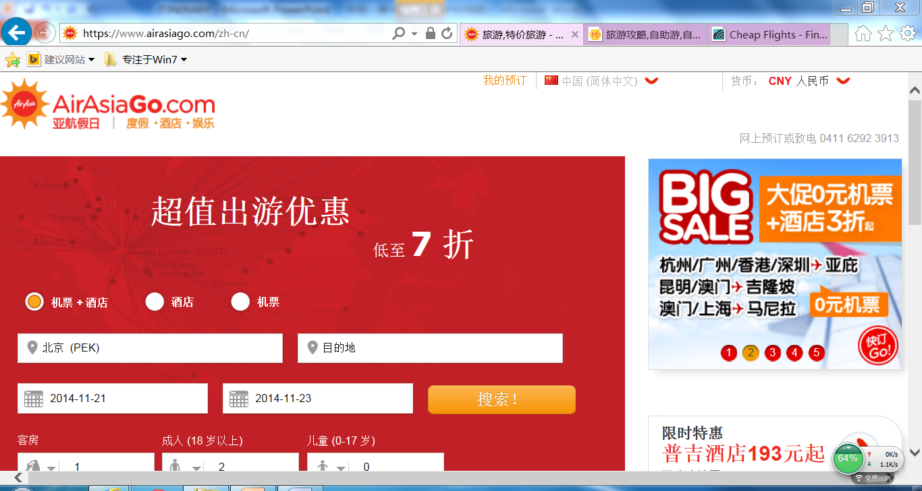
www.airasiago.com

Slide 9
Booking
www.ctrip.com
www.agoda.com
www.booking.com

Slide 10
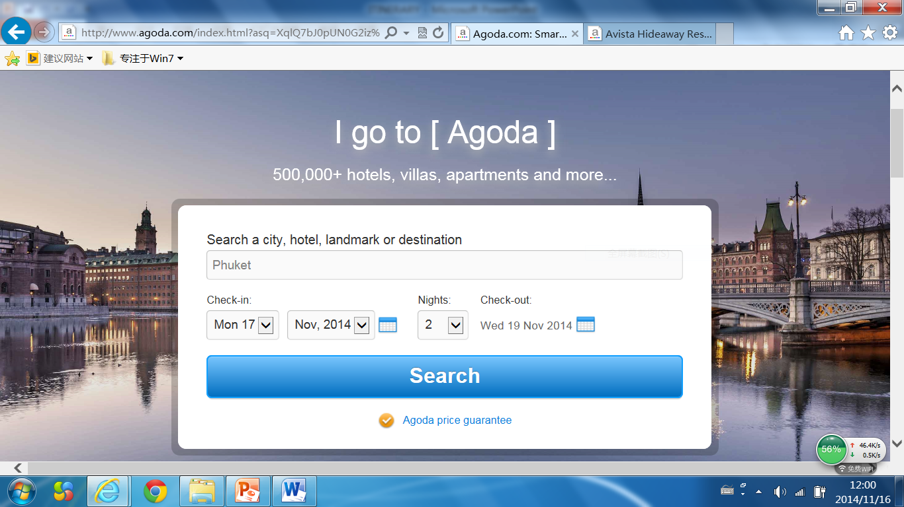
www.agoda.com

Slide 11
Getting Ready to Go
Passport
Visa
Arrival/Departure Card
Customs Declaration Form

Slide 12
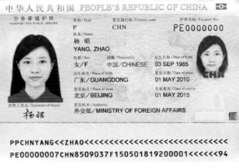
Passport

Slide 13
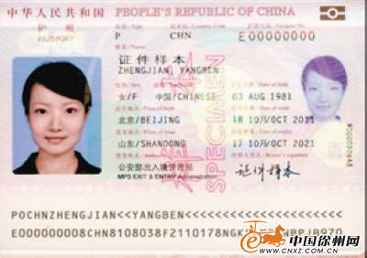
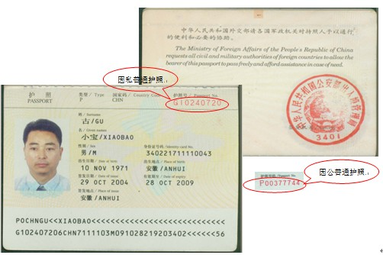

Slide 14
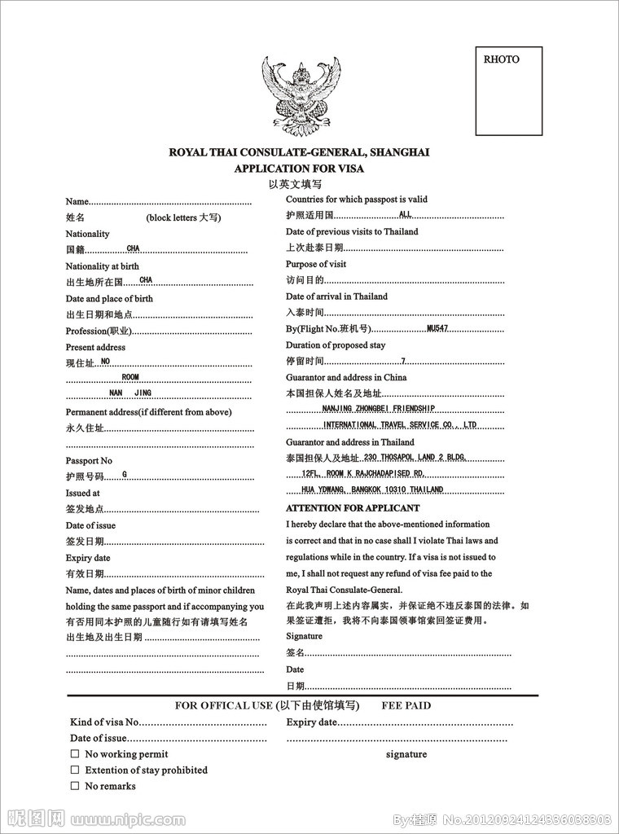
Visa

Slide 15
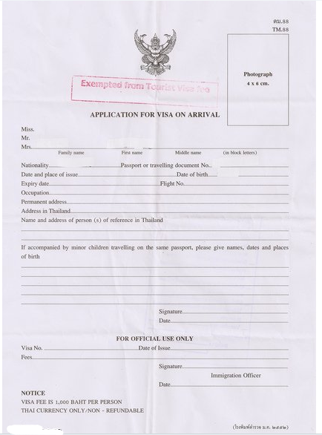
Visa on Arrival

Slide 16
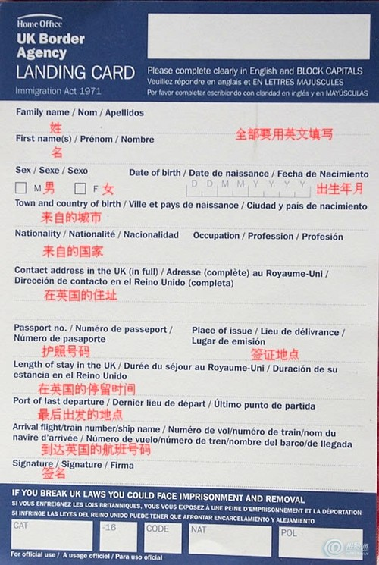

Slide 17
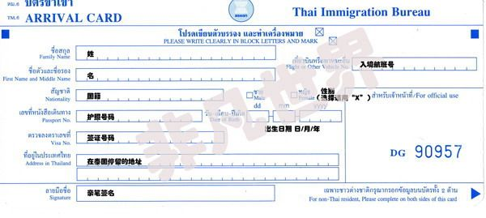

Slide 18
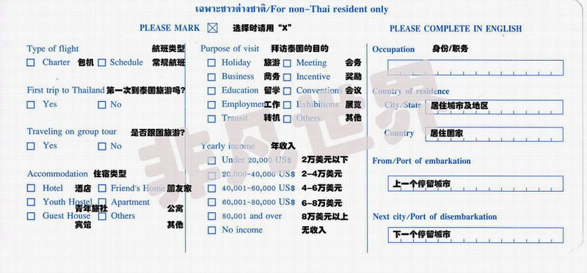

Slide 19
Arrival Card
1. Family Name 姓
2. First (Gicen) Name 名 |  |  |  |  |  |  |  |  |  |  |  |  | 3. Birth Date (day/mo/yr) 出生日期（日/月/年）
4. Country of Citizenship 国籍 |  |  |  |  |  |  |  |  |  |  |  |  | 5.Sex (Male or Female) 性别（男或女）
6.Passport Number 护照号 |  |  |  |  |  |  |  |  |  |  |  |  | 7.Airline and Flight Number 航班号NumberHANG航班号
8.Country Where You Live居住的国家 |  |  |  |  |  |  |  |  |  | 9.City Where You Boarded居住的城市
10.City Where Visa Was Issued获得签证的城市 |  |  |  |  |  |  |  |  |  |  |  |  | 11.Date Issued (day/mo/yr) 签证日期（日/月/年）
12.Address While in the United States (Number and Street)在美地址（含街道和门牌号）
13.City and State（上述地址所在）城市和州

Slide 20
Departure Card
1. Family Name 姓
2. First (Gicen) Name 名 |  |  |  |  |  |  |  |  |  |  |  |  |  |  |  |  |  |  |  |  | 3. Birth Date (day/mo/yr) 出生日期（日/月/年）
4. Country of Citizenship 国籍

Slide 21
Customs Declaration

Slide 22
Groupwork
Pick a destination.
Write an itinerary.
Make up your travel story to provide more information, e.g. passport etc.
Exchange your stories and fill in the forms.

Slide 23
Sample
Li Tian who is holding a Chinese passport (E10245678) with a Thailand visa (No.2148776) is on a trip from Hangzhou to Bangkok to celebrate her 27th birthday. This morning, her flight CA773 took off from Hangzhou Xiaoshan International Airport, and now it is arriving at the Suvarnabhumi Airport of Bangkok. Ms. Li is in a hurry to meet her friends at Siam Kempinski Hotel, 991 Rama Road, Pathumwan, Bangkok. Please help her fill in the arrival card.

Slide 24

Plan for Your Vacations. Enjoy your trip!

